Slide 1
L5-SNA
Musica Supriya

Slide 2
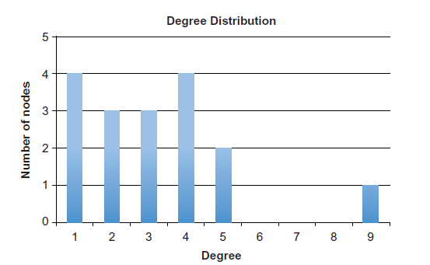
Describing Nodes
Degree is used to describe individual nodes, to better understand this we can build degree distribution

Slide 3
Density
Density= number of edges/number of possible edges

Slide 4
What is the Number of possible edges in the graph shown below?

Slide 5
Undirected Network
No. of possible edges for n nodes = n*(n-1)/2
Density for the network with edges e and nodes n is:
Density= e/[n*(n-1)/2]
0.357

Slide 6
Calculate density for the below graphs
0.179
0.571

Slide 7
Directed Network
No. of possible edges for n nodes = n*(n-1)
Density for the network with edges e and nodes n is:
Density= e/[n*(n-1)]

Slide 8
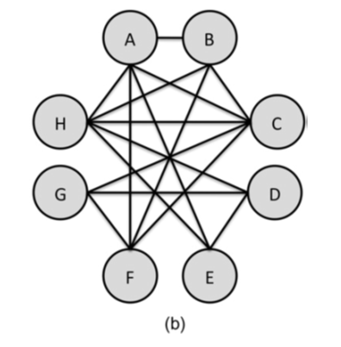
Density in egocentric network
While calculating density consider a 1.5 diameter network
Exclude the ego node
Draw the egocentric network wrt node A and nodeB
Fig 3.6

Slide 9
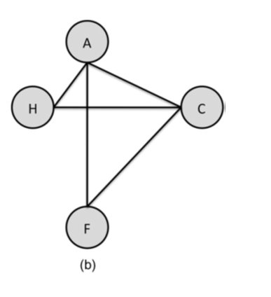
Calculate density for the below graphs
B
H
Wrt Node B
C
Wrt Node A
E
F
0.833
0.6
(a)
Fig 3.7 : 1.5 Diameter egocentric network for Fig 3.6

Slide 10
Note: Density of an egocentric network is sometimes referred as local clustering coefficient
Density measure the percentage of possible edges in the graph

Slide 11
Connectivity
Minimum number of nodes that would have to be removed before the graph becomes disconnected
There is no longer a path from each node to every other node
Also known as cohesion

Slide 12
What is the connectivity here?

Slide 13
What is the connectivity here?

Slide 14
